Slide 1
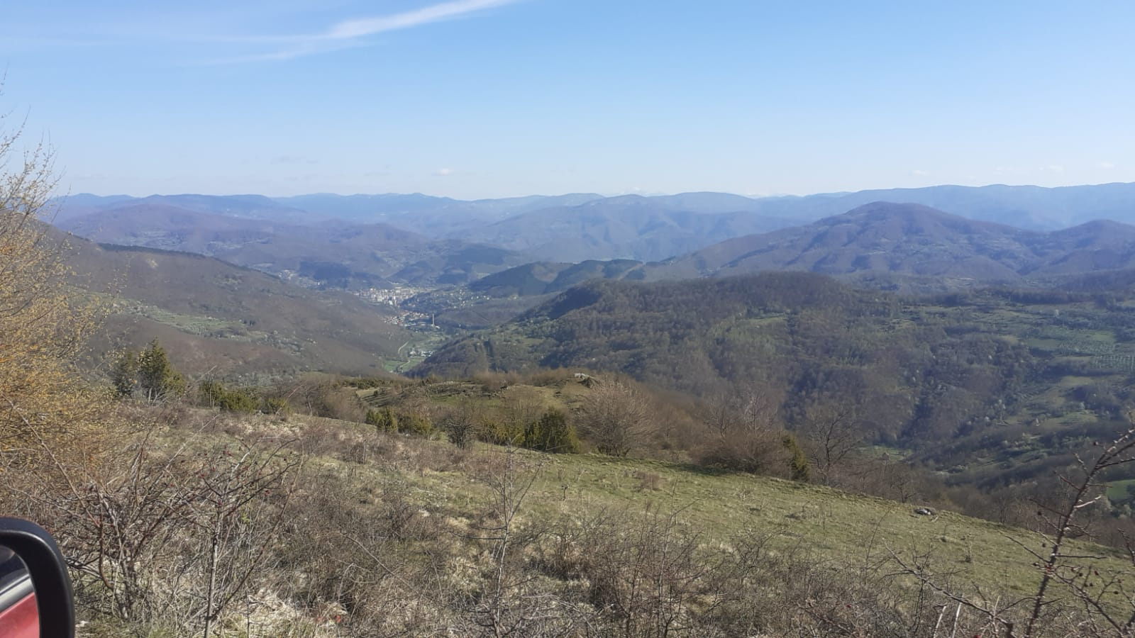
A Duke of Wellington’s Regiment fundraising campaign to contribute towards a British Army Memorial Park to commemorate the service of all 1 DWR Battle Group personnel during Op Grapple in Bosnia & Herzegovina in 1994

Slide 2
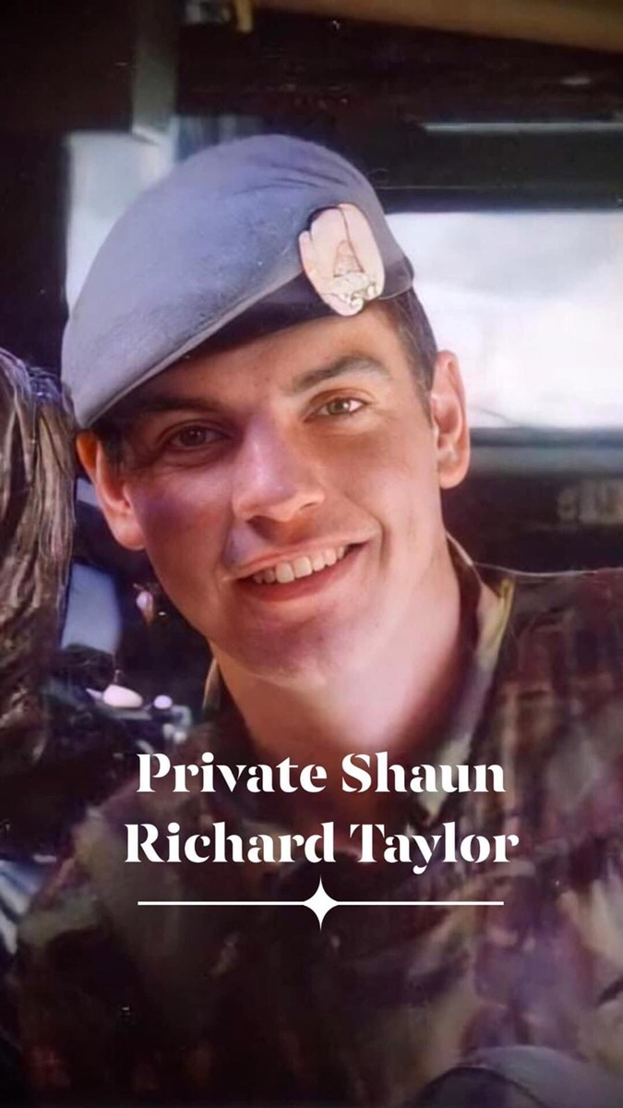
Honour & Inspire Project Overview
The total cost of the Memorial is £43,176.
The RGBW and SAS Regt Associations and veterans have committed to raise £15k each for the Memorial.
RWF have been contacted but the Memorial Organising Committee have not yet received their commitment.
The DWR Regimental Trustees have provided a donation of £5k and have committed to underwrite a further £10k if not provided by charitable donations raised through other fundraising activates (Currently standing at £1,442).
In parallel it is agreed that the Regimental Trustees will enable Pte Taylor's family to be represented at the unveiling of the memorial in Sep 2022.
In addition to the funding of the Memorial it is intended that a living legacy to Pte Taylor’s sacrifice and the contribution of The Dukes’ will be created by renovating a classroom in Pte Taylors honour. The funding for this element of the project will come from fundraising efforts of those involved in the Honour and Inspire Bike Ride (Sarajevo-Gorazde 12-15 Sep 22 – currently there are 7 Dukes signed up).
The priority for the DWR Org Cte is to fund the Memorial (£15k) and subsequently provide funds for the school renovation with a combined overall target of £35k.

Slide 3
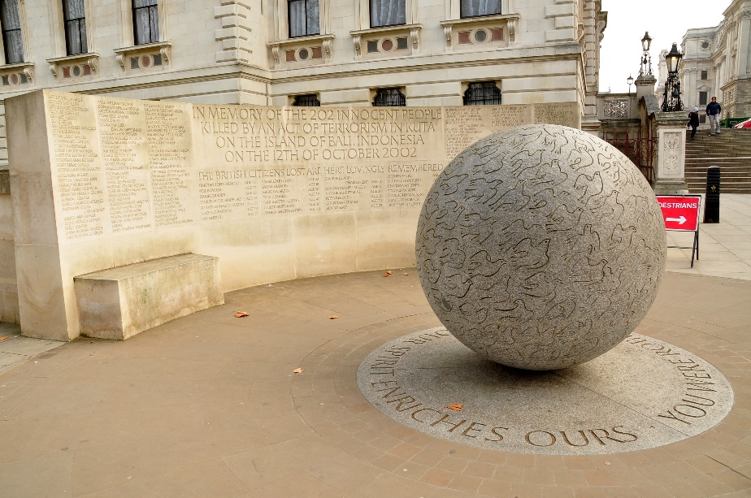
Overview of the British Army Memorial Park
    The planned design of the Gorazde British Army Memorial Park takes its inspiration from the memorial to those killed in the 2002 Bali Terrorist Attack designed by Gary Breeze. Breeze has given his approval to utilise the design.
    There is significant Local buy-in to the design, build, installation and maintenance of the memorial, with the previous investment and contribution by the GCF Bosnia Charity having won considerable local trust and buy into this effort.
    The land upon which the memorial will sit has been gifted by the local council, a local Stonemason has been identified, and groundworks will begin in May 2022 with regular updates provided to the organising committee (Mike Wolff is DWR representative)
    A plan has been agreed with the school in Gorazde that will see full cleaning and maintenance of the memorial being conducted twice a year (on the Regimental Days). Senior students will be tasked to ensure the memorial is maintained to the appropriate standards, and education of the students re the stories and meaning behind the memorial will also take place.
    Education is a critical part of the rationale behind this memorial. It is intended that the bronze panoramic map will contain information on the British Army’s deployment to Gorazde, and the positive effect it had on stabilising the situation during an intense civil war, safeguarding the lives of thousands of civilians in the region.
    Project managed by Gwen Wilcox, COO Armstrong Wolfe. Local contact ex-Interpreter Muki Tutic MBE
Memorial to those killed in the 2002 Bali Terrorist Attack, London

Slide 4
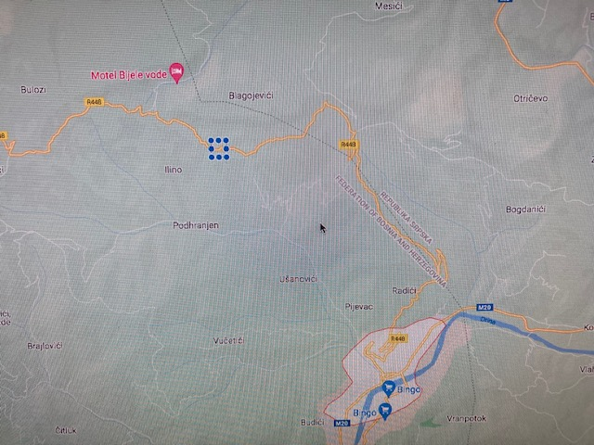
The view from the proposed memorial park site
The location of the proposed memorial park site, 6km North of the town centre

Slide 5
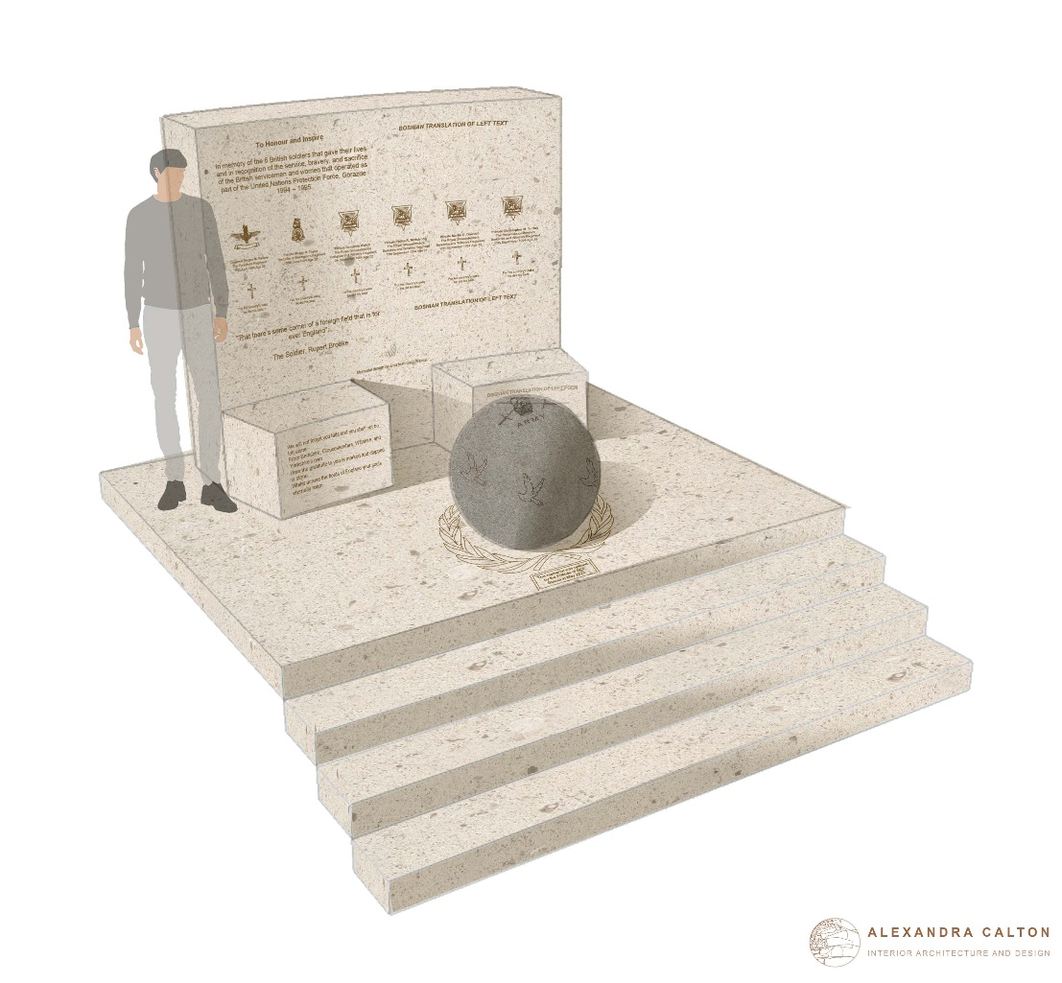
Overview of the British Army Memorial Park
    It is envisaged that on the rear wall there will be a memorial poem (Rupert Brooke ‘The Soldier’) which will be written in both English and Serbo-Croat. Furthermore there will be 6 panels which will be of a consistent templated design, with each panel bearing the regimental emblem and details of the members of those units who lost their lives whilst serving in and around Gorazde.
    The concrete sphere in front of the wall be a replica of the Planet Earth with 6 doves circling the sphere representing the fallen. The sphere will rest upon a base plate which will have the crest of the United Nations emblem carved into it.
    In addition to the wall and the sphere, it is envisaged there will be a number of wooden benches placed around the memorial for visitors to use during any visit. There will also be a bronze plaque placed at an appropriate site in front of the memorial upon which a panoramic guide will be engraved showing the positions of UN Observation Posts manned by British Army units during the Op Grapple tour. A small car parking area is also planned to be placed alongside the memorial for ease of access.

Slide 6
DWR Gorazde Memorial Comms Plan
Date | Activity | Responsible | Comms channel | Remarks
23 Apr | LI/FB Post | Nick Borwell | FB | Commemorate when Alma deployed to Gorazde
28 Apr | LI/FB Post | Mike Wolff | FB/LI | Cpl S Mills CGC
30 Apr 22 | SteerCo | MN | Teams
W/C 2 May | Engage Harry SO | MN |  | Offer of fundraising advice, guidance, and support
6 May 22 | Coord Call | MN | Teams | MW, GK, MN, BW provide update to DSO, NB, DB, MN, SN
W/C 9 May 22 | LI/FB Post | Duncan Bruce | LI/FB | Recollections of Gorazde
W/C 16 May 22 | RHQ Letter to Regt Dist List | MN | E Mail/Post actioned by RHQ | Note content complete add DWR letterhead. Engage John Hogg/David Harrap
W/C 16 May 22 | Article on DWR Website | MN | Post on The Duke of Wellington's Regiment (West Riding) Regimental Association (dwr.org.uk) | Engage John Hogg/David Harrap
27 May 22 | SteerCo | MN | Teams
W/C 30 May 22 | Engage DLG | GK | E mail | Distribute Cycle/Fundraising update via dlgconvenor@gmail.com
W/C 30 May 22 | LI/FB Post | Martin Ness | LI/FB | Recollections of Gorazde
17 June 22 | SteerCo | MN | Teams
18 June 22 | LI/FB Post | MW | FB/LI | Waterloo Day
26 June 22 | Local Media | MW/MN | Yorkshire media | Contact local media via RHQ. Recognise the death of Shaun Taylor. Coord Angela Plews
1 July 22 | SteerCo | MN | Teams
W/C 4 July 22 | LI/FB Post | MW | FB/LI | Waterloo Day
W/C 18 July 22 | LI/FB Post | David S-O | FB/LI | Recollections of Gorazde
4 Aug | Hindoostan Cup | GK | Fines | ‘Fines’ to go to Gorazde Memorial Fund

Slide 7
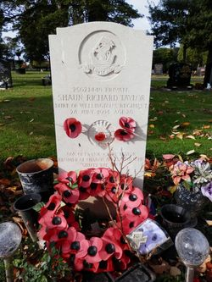
Request for support
Engage in the use of social media to gain funding from across DWR community for the Memorial.
Utilise contacts and corporate funding for the Memorial – advice from a professional fundraiser (Harry S-O) was that the social media campaigns would gain a drip feed of donations, but it would be far more effective to highlight 20 key contacts each who would respond to a personalised e mail.
  ‘This means an awful lot to me and I am looking for your support to recognise the contribution of the British Army in preventing genocide in Gorazde in 1994’
Join the Sarajevo-Gorazde Bike Ride – 12-15 Sep

Slide 8
Appendix

Slide 9
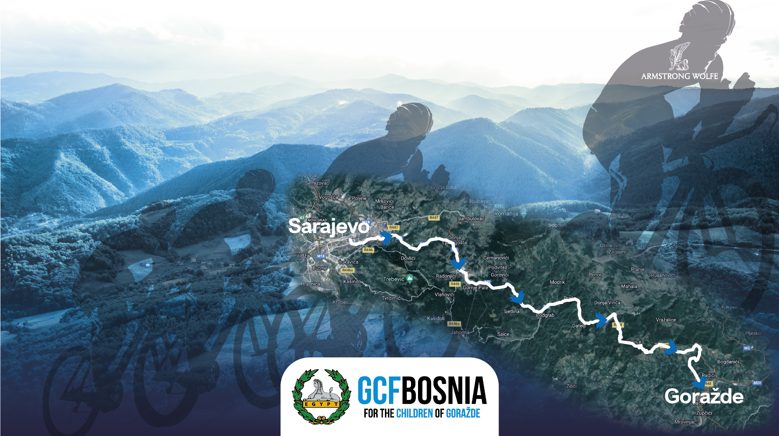
Itinerary:
Day 1: Travel from London Heathrow to Sarajevo; Tour of the old town; Bike pick up; Dinner and stay at the Hotel Europe.
Day 2: 100Kms cycle ride from Sarajevo to Gorazde, with a celebratory finish at the primary school in Gorazde. After the celebrations, we shall be exploring the Cemetery Valley, and the beautiful Samari Summit. Dinner and stay in a mountain lodge to end the evening.
Day 3: We start the day with a memorial service to the six British soldiers, with the unveiling of a new viewing platform, accompanied with benches, a memorial plaque, and a panorama map. This will then be followed by a scenic journey down the breath-taking Drina River, ending the evening by returning to Sarajevo with a team dinner in the old town.
Day 4: Visit to the 1984 Olympic village; Transfer to Sarajevo airport - Return to the U.K. (airport transport provided).
12th - 15th Sep 2022
Bosnia and Herzegovina
Fundraiser

Slide 10
Honour and Inspire Charity Ride
To secure your space, we would be grateful to receive a confirmation that you will be joining the trip, along with your initial participation of £1250 to be paid directly into the charity (details to be sent upon confirmation)- this will secure your accommodation/ Breakfasts/ Lunches and Dinners (apart from Day 1) and cost of the bike/ helmet.
Please note that we would also require, if possible, for you to raise monies towards the team target of £40,000 through our JustGiving page the additional fee will truly support the renovation work at the primary school and maintenance of the memorial area.
For further information, please peruse the GCF Bosnia website www.gcfbosnia.org – You will be able download our 2022 presentation which provides a more in-depth look on the costs, background, and itinerary of the trip (Press 2022 Presentation)- it may also help you if the organisation you work for is willing to support your fundraising effort.
If you are not able to attend, but would still like to support the charity and those taking part, you can donate to the charity directly by following this JustGiving link: www.justgiving.com/gcf-bosnia
Please send any questions to the following charityridebosnia2022@armstrongwolfe.com email address, we would be more than happy to answer any queries that you may have.
Project Management Team is below :
  Maurice Evlyn-Bufton, RGBW Contact and Charity Lead- maurice.evlyn-bufton@armstrongwolfe.com
  Theresa Foden, CEO’s office, Armstrong Wolfe Theresa Foden T.Foden@armstrongwolfe.com
  Nick Scott, Armstrong Wolfe, BNYMellon - ncscott147@gmail.com
  Gwen Wilcox, COO Armstrong Wolfe - G.Wilcox@armstrongwolfe.com
  Mike Wolff, DWR Contact and Lead
  Muki Tutic, Former BiH Officer & Friend of the Charity
  Dzenana Bukva, Gorazde Primary School, English Teacher

